Slide 1
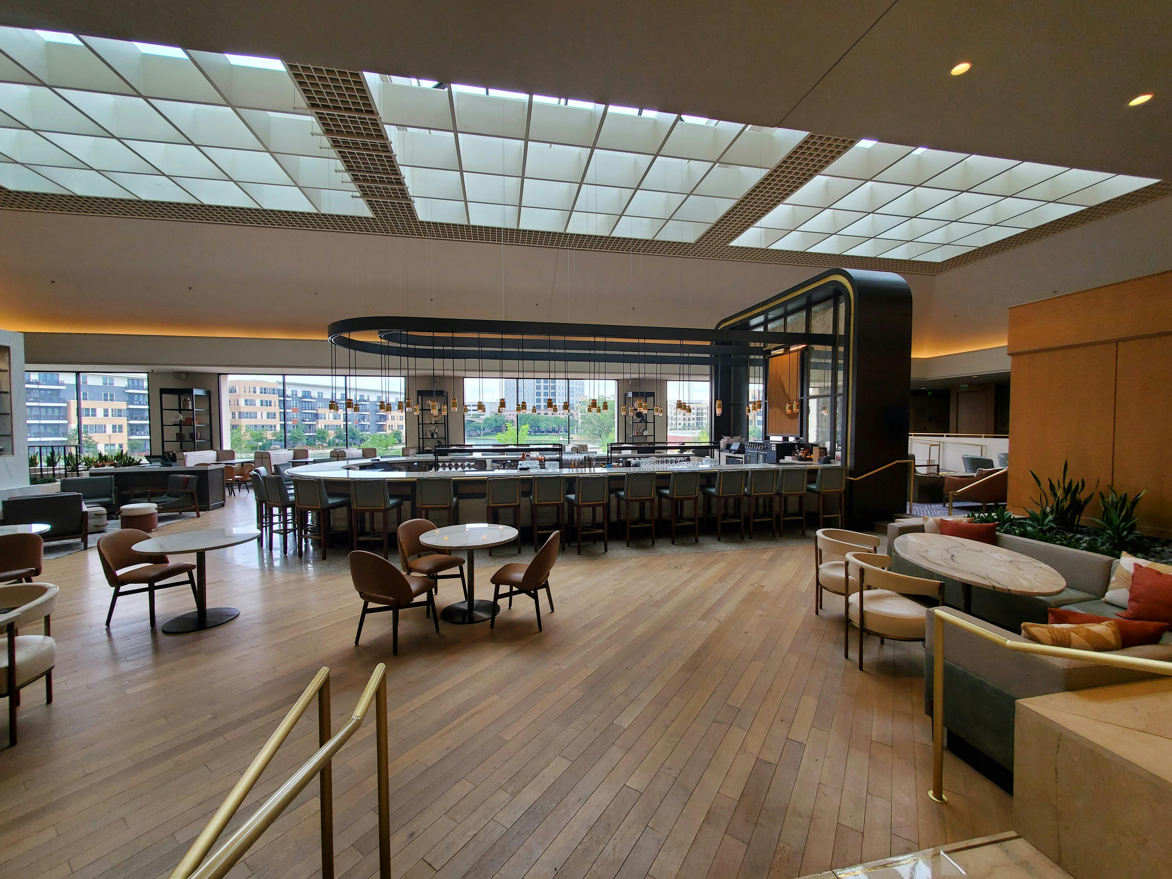
EDA
Hotel Booking
Presented by
Shubham Mhaske
Guided by
Abhishek Sir

Slide 2
Content
Project Overviews
Project Objective
Raw Data Preview
Know Your Variable
Data Transformations
Data Visualization and Insight
Conclusion

Slide 3
Project Overviews & Objective
The objective of this project is to analyze the business performance of City Hotel and Resort Hotel from 2015 to 2017. The study evaluates operational efficiency, customer satisfaction, and financial performance of both hotels. It also examines occupancy levels, revenue management, and sales and marketing strategies.
The project aims to identify key performance trends and challenges. Based on the analysis, strategic recommendations are proposed to enhance profitability and support sustainable growth

Slide 4
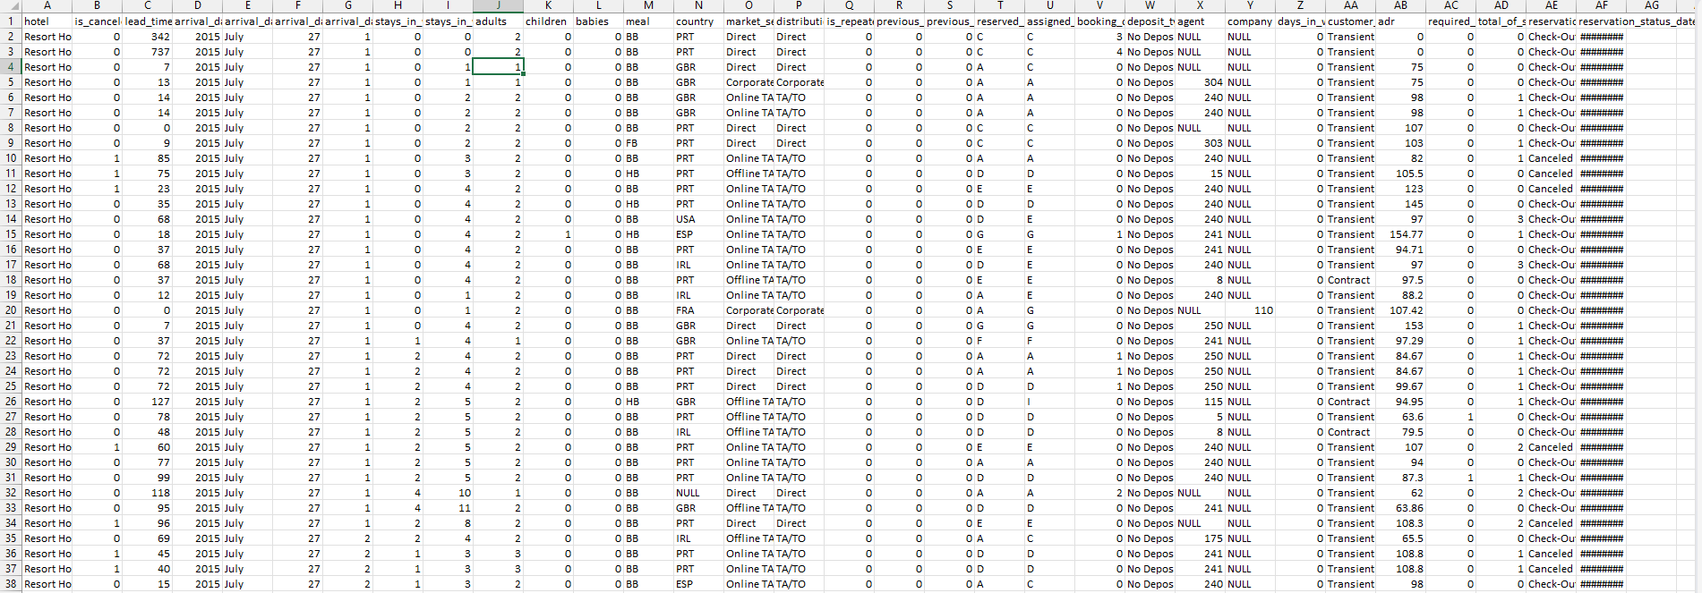
Raw Data Preview

Slide 5
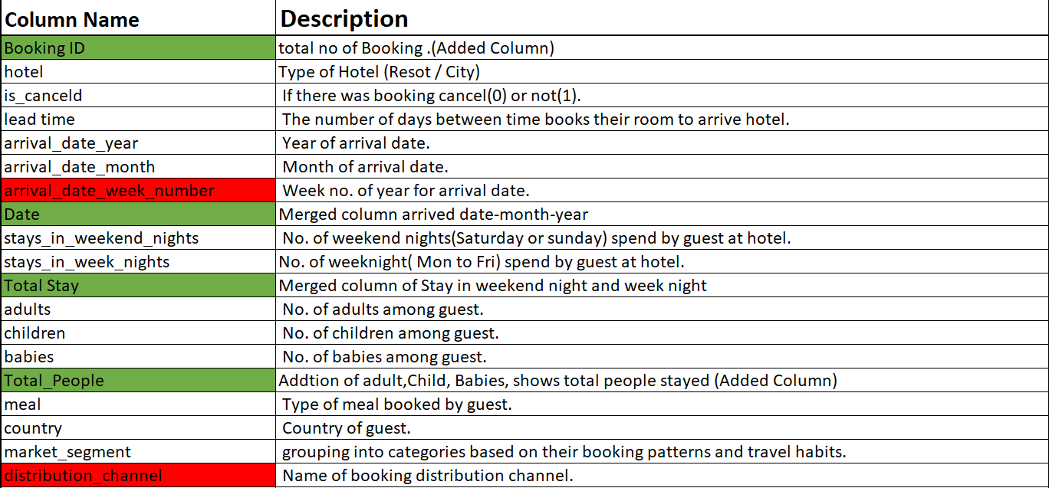
Know Your Variable
Added Column
Removed Column

Slide 6
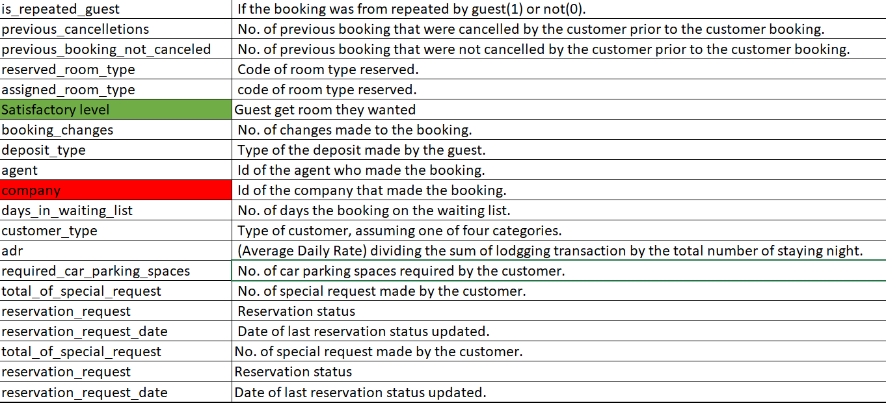
Know Your Variable
Added Column
Removed Column

Slide 7
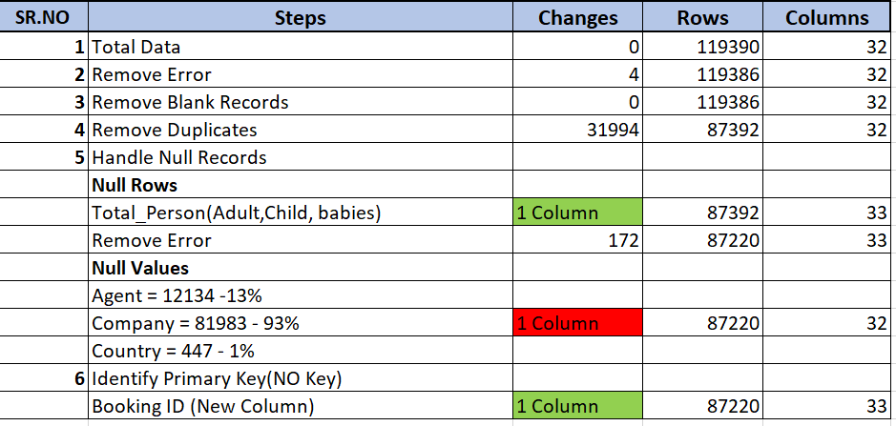
Data Cleaning
Added Column
Removed Column

Slide 8
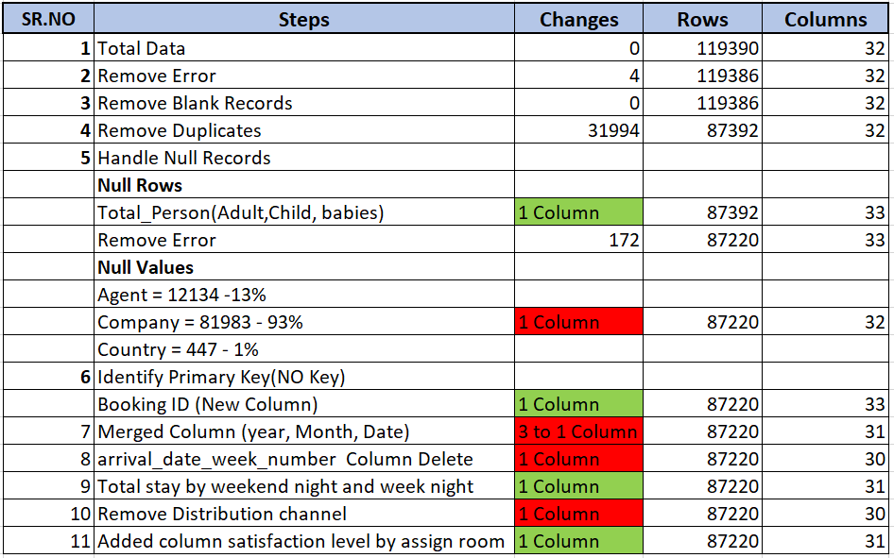
Data Cleaning
Added Column
Removed Column

Slide 9
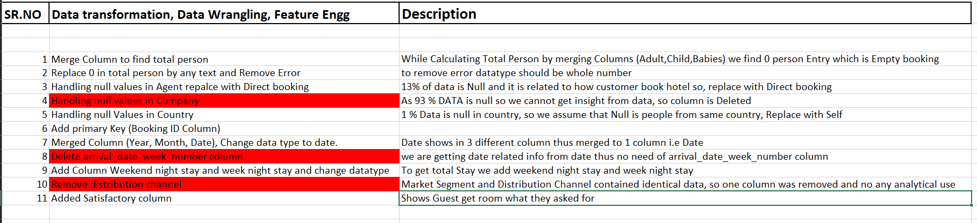
Data Transformation

Slide 10

Data Visualization and Insight

Slide 11
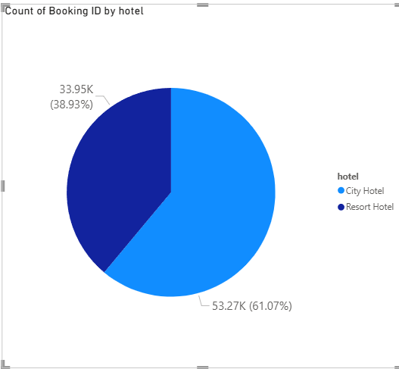
Most Preferred hotel
I picked this chart because it clearly shows the booking share between City Hotel and Resort Hotel.
It reveals that City Hotel has a larger booking volume (61%) compared to Resort Hotel (39%).
This insight helps focus efforts on improving Resort Hotel’s performance to increase overall business growth.

Slide 12
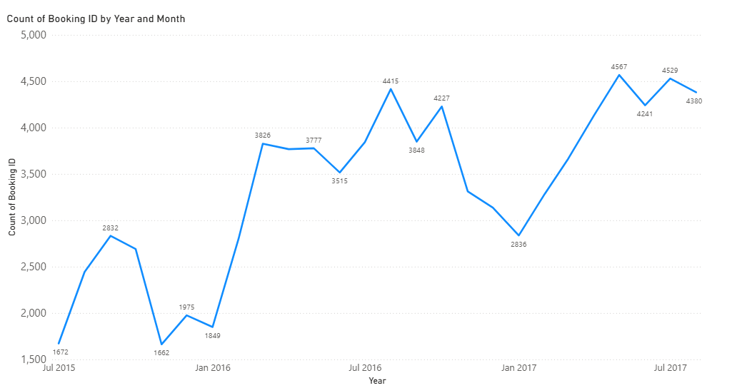
Year Wise Bookings
The chart shows strong seasonal fluctuations with consistent summer peaks and sharp January dips. There is also an overall positive growth trend year-over-year.
These insights lead to positive business impacts through better proactive planning, allowing for optimized pricing strategies and resource allocation.
The data chart displays significant seasonal fluctuations in monthly booking IDs from July 2015 to July 2017. Bookings consistently peak during summer months (July) and drop sharply in January of each year.

Slide 13
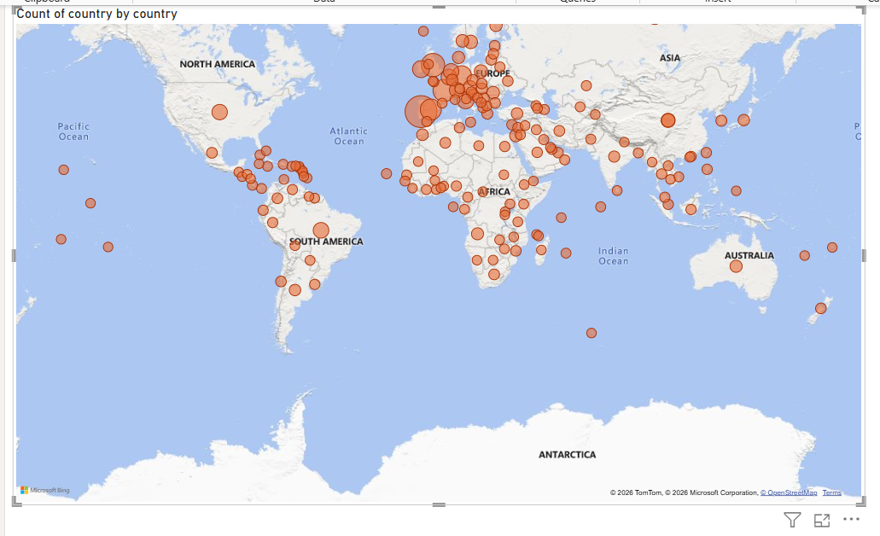
Country wise Guest
The Map shows from which country the maximum number of guests visit.
Based on the map, we can say that most guests visit from Portugal, the UK and France, i.e., approx. 27.45K, 10K and 9K people respectively.

Slide 14
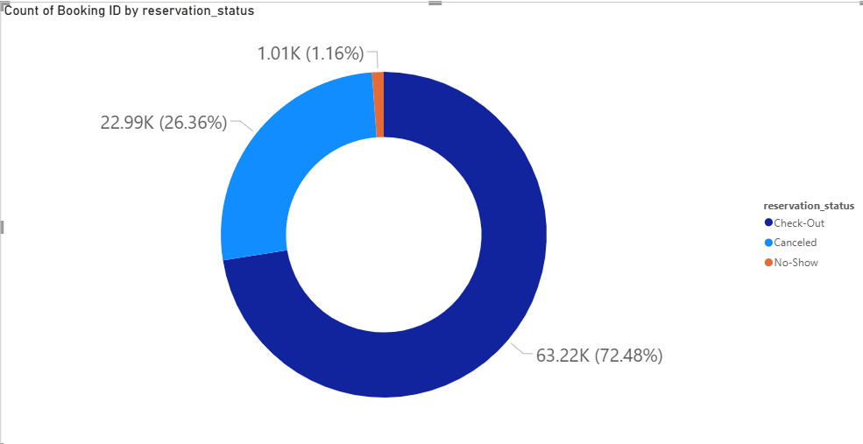
Reservation Status Ratio
Based on the Donut chart, we can say out of all the bookings, 72.51% of guests Checked-Out, 26.33% of guests Cancelled the booking, while only a small percentage, i.e. 1.16% of guests, were a No-Show.

Slide 15
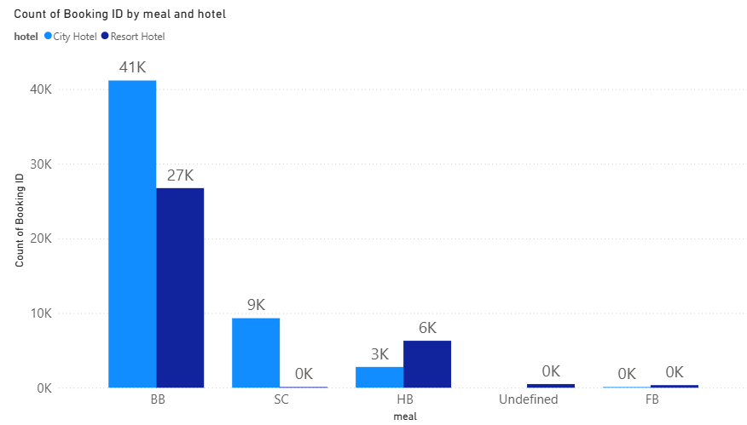
Most Preferred Meal Hotel Wise
The Clustered Column chart shows the most preferred meals for guests of different hotels.
Based on the bar chart, we can say that most guests prefer BB meal type, which is approx. 41K people for City Hotel and 27K for Resort Hotel.

Slide 16
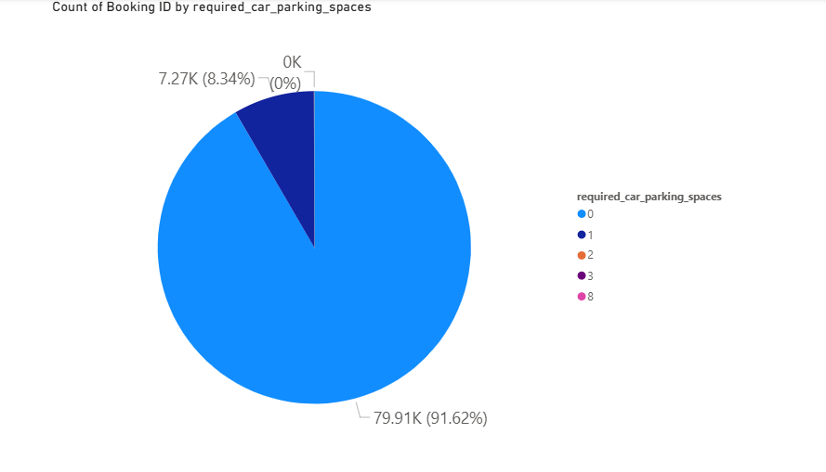
Parking Space Required by Guest
This Pie chart shows clear ratio for Parking space required by guest.
Most guests (over 90%) don’t need parking, so parking capacity can be limited to reduce costs.
Maintain a small, well-managed allocation for single-space requests to meet demand efficiently.

Slide 17
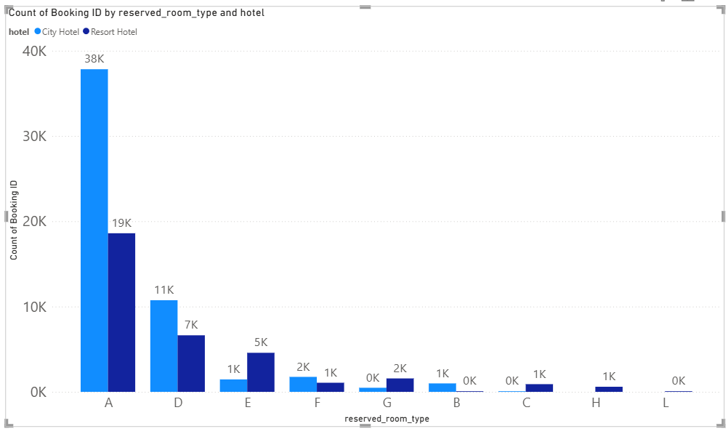
Most Preferred Room Type
This Clustered column chart shows clear ratio between the preferred room type with hotel type.
Data Shows most preferred rooms are A and D.
We can apply similarities of A and D Rooms to the rest of room to avoid miss assignment and increase satisfaction level of customer

Slide 18
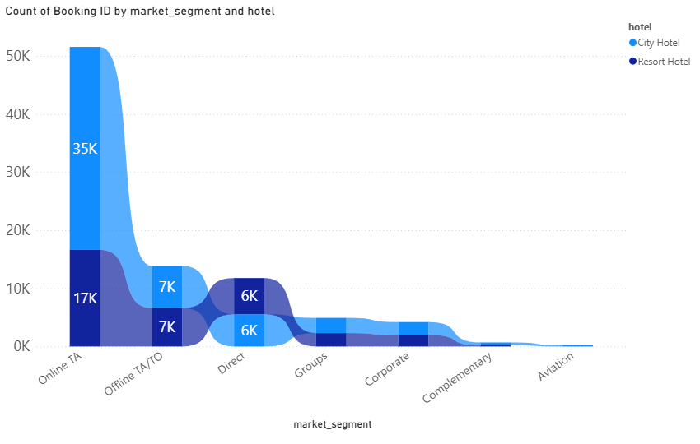
Most Preferred Market Segment
The Ribbon chart shows the most preferred market segment for different hotels.
Based on the ribbon chart, we can say that the most preferred market segment is Online TA, which is approx. 35K for the City Hotel and 17K for the Resort Hotel, respectively.

Slide 19
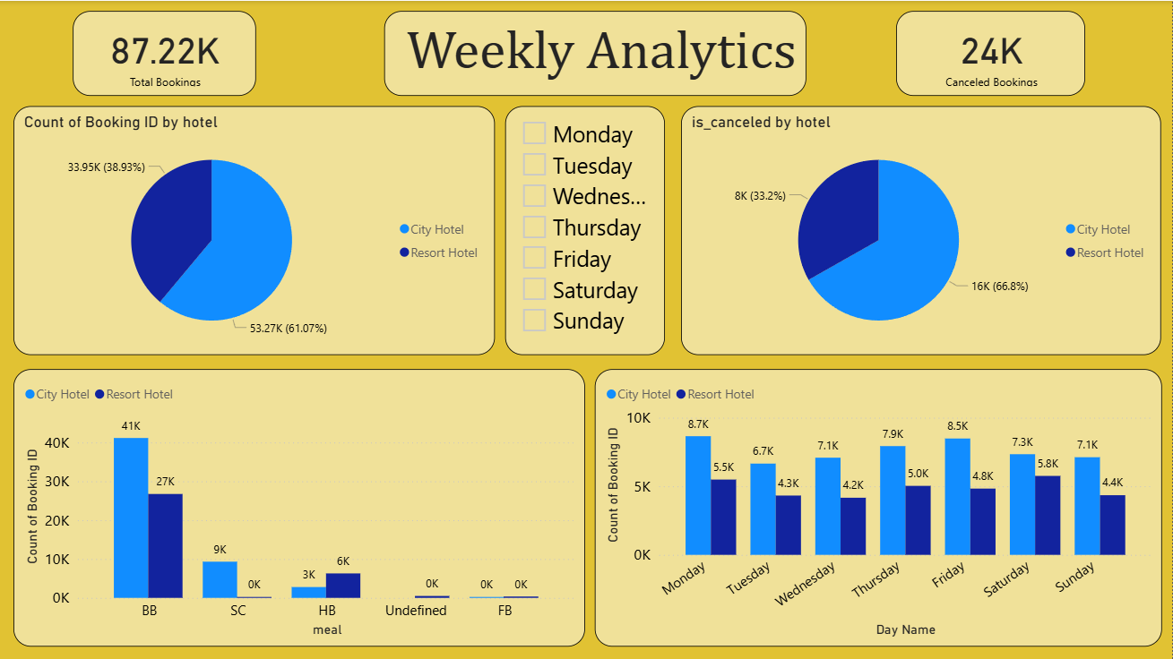

Slide 20
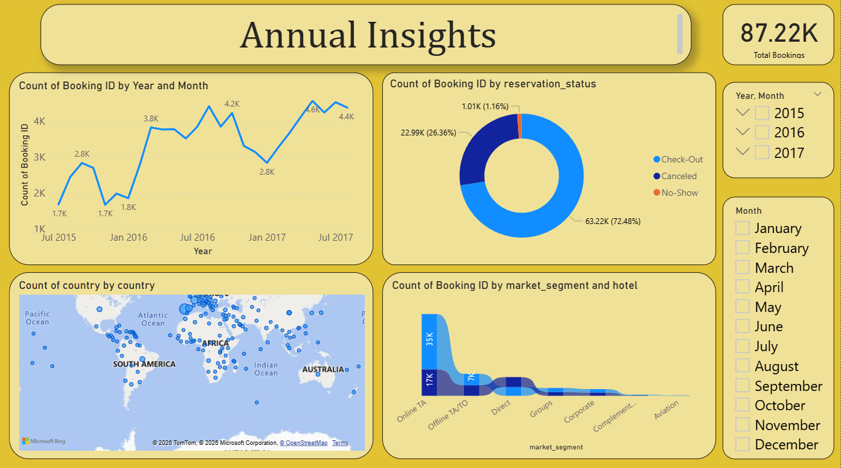

Slide 21
Conclusion
Top Performance: City hotels are the preferred choice, with peak bookings and revenue recorded in 2016.
Infrastructure: Minimal guest demand for parking suggests that further investment in parking facilities should be limited.
Seasonality: Booking volumes peak annually during July and August, driven by the summer holiday season.
Distribution & Demographics: Most reservations flow through travel agents, with the largest customer bases originating from Portugal, the UK, France, and Spain.
Room & Board: Guests most frequently book Room Types A and D, while Bed & Breakfast (BB) remains the dominant meal plan.

Slide 22
Thank You

